Slide 1

Data insights for 2020
By: Ankit Kumar

Slide 2
Overview
Good morning, everyone. Today, we are here to present the data-driven answers to the business questions posed by the Rockbuster Stealth Management Board. These answers will be used to inform the company's 2020 strategy.
Our presentation will cover the following questions and how we used data to answer them:
● Which movies contributed the most/least to revenue gain?
● What was the average rental duration for all videos?
● Which countries are Rockbuster customers based in?
● Do sales figures vary between geographic regions?
● Where are customers with a high lifetime value based?

Slide 3
HOW We Answered the Questions
To answer these questions, we utilized a variety of tools, including SQL queries, data tables, and functions
Now, let's dive into each of the questions and their answers

Slide 4
Which movies contributed the most/least to revenue gain?
To answer this question, we created bar graphs that show the top 10 and bottom 10 movies based on their contribution to revenue gain. The graph shows that the movie “Telegraph Voyage" was the highest contributor to revenue gain, while “Duffel Apacolypse" was the lowest

Slide 5
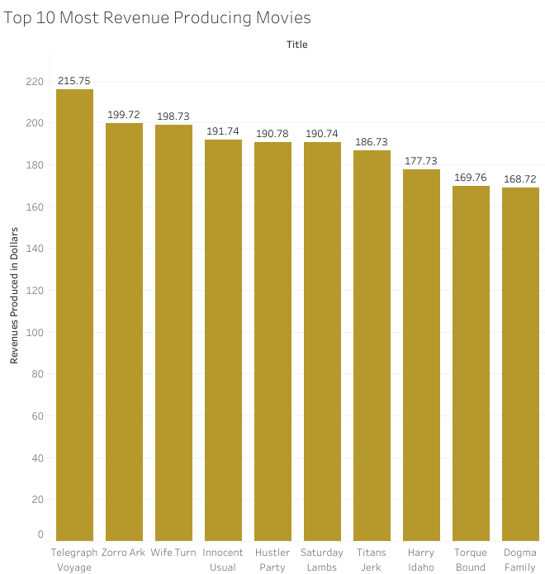
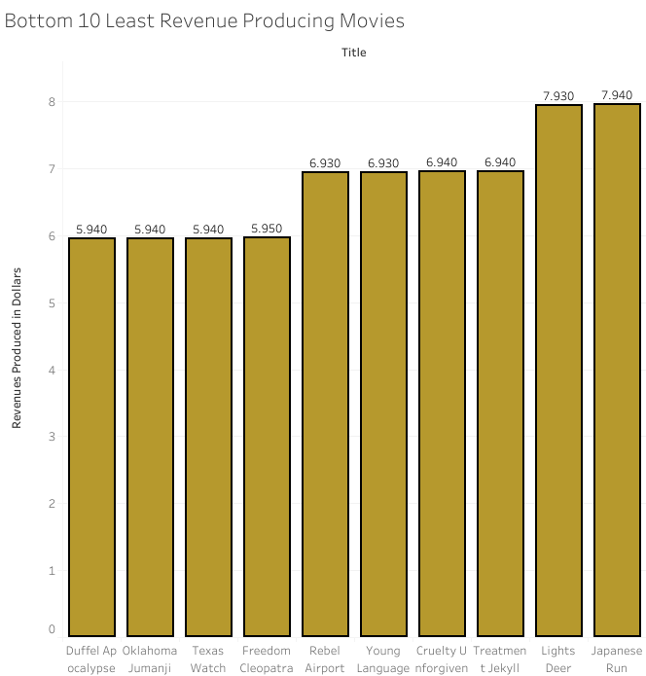
Which movies contributed the most/least to revenue gain?

Slide 6
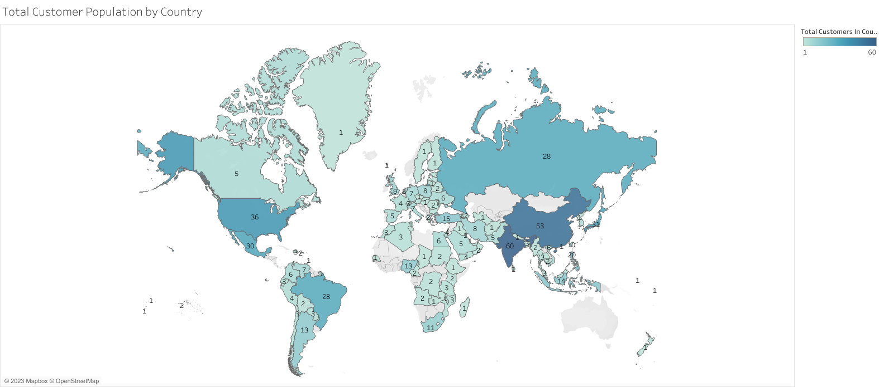
Customer Concentration by Country

Slide 7
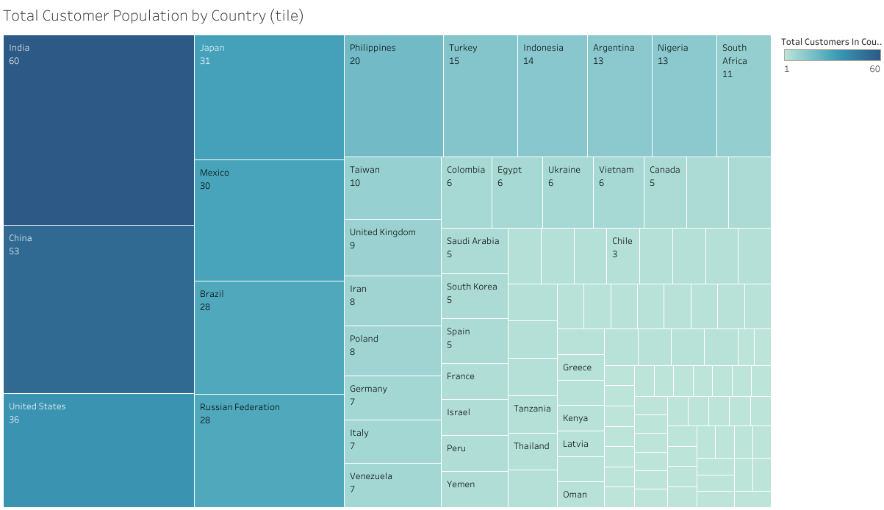
Customer Concentration by Country

Slide 8
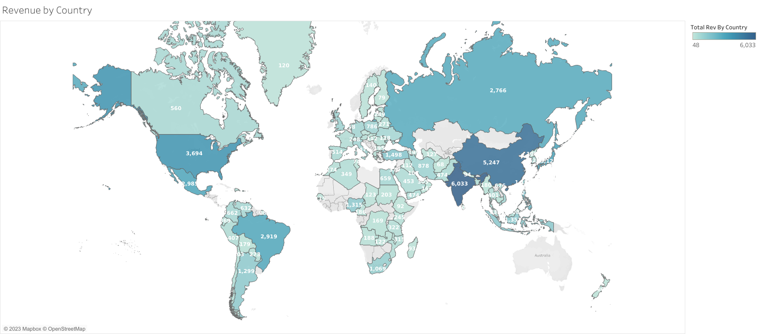
Revenue Concentration by Country

Slide 9
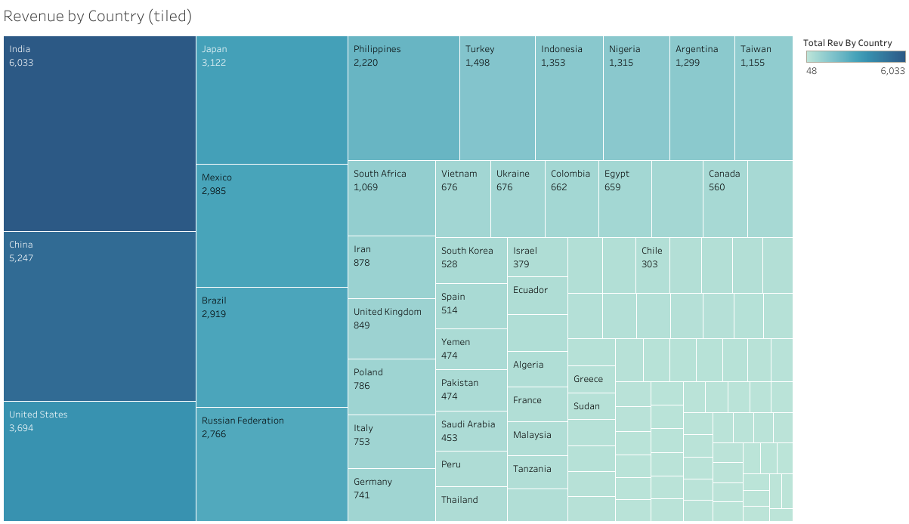
Revenue Concentration by Country

Slide 10
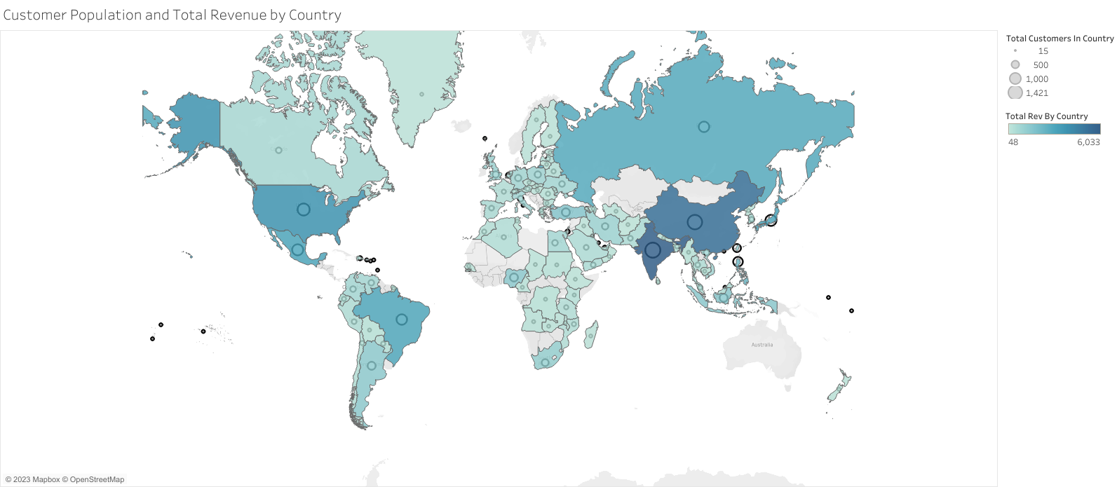
Top Revenue and Customer Concentration by Country

Slide 11
Countries where customers with a high lifetime value base reside
India
China
Japan
Mexico
United States
These countries are important markets for Rockbuster, and understanding the preferences and behavior of customers in these countries can help inform business decisions and strategies. With this information, Rockbuster can tailor its offerings and marketing efforts to better serve these customers and maximize revenue.

Slide 12
Some Interesting and Useful Quantitative Findings
Statistic | Value
Minimum Rental Duration | 3
Maximum Rental Duration | 7
Average Rental Duration | 4.985
Minimum Rental Rate | 0.99
Maximum Rental Rate | 4.99
Average Rental Rate | 2.98
Minimum Replacement Cost | 9.99
Maximum Replacement Cost | 29.99
Average Replacement Cost | 19.984
Minimum Film Length | 46
Maximum Film Length | 185
Average Film Length | 115.272
Mode Rating | PG-13

Slide 13
In conclusion, our analysis of the Rockbuster data has provided valuable insights into key business questions and helped inform our 2020 company strategy. We have identified top-performing movies, rental durations, customer countries, and geographic regions with varying sales figures. We have also pinpointed where customers with high lifetime value are based.
Based on our analysis, we recommend that Rockbuster focus on the following:
Developing marketing campaigns and offerings that cater to the top-performing movies identified in our analysis, to increase revenue and customer engagement.
Optimizing rental durations based on the average rental duration identified in our analysis, to maximize customer satisfaction and loyalty.
Targeting customer countries identified in our analysis, such as the United States, India, China, Japan, and Mexico, to expand the customer base and increase revenue.
Examining geographic regions with varying sales figures identified in our analysis, such as the difference between sales in North America and Europe, to identify opportunities for growth and improvement.
By implementing these recommendations, Rockbuster can improve its competitive position in the market and achieve long-term success.

Slide 14
Links to Visualizations
Customer Population and Total Revenue by Country | Tableau Public
Revenue by Country(tiled) | Tableau Public
Revenue by Country | Tableau Public
Total Customer Population by Country (tile) | Tableau Public
Total Customer Population by Country | Tableau Public
Bottom 10 Least Revenue Producing Movies | Tableau Public
Top 10 Most Revenue Producing Movies | Tableau Public

